Slide 1
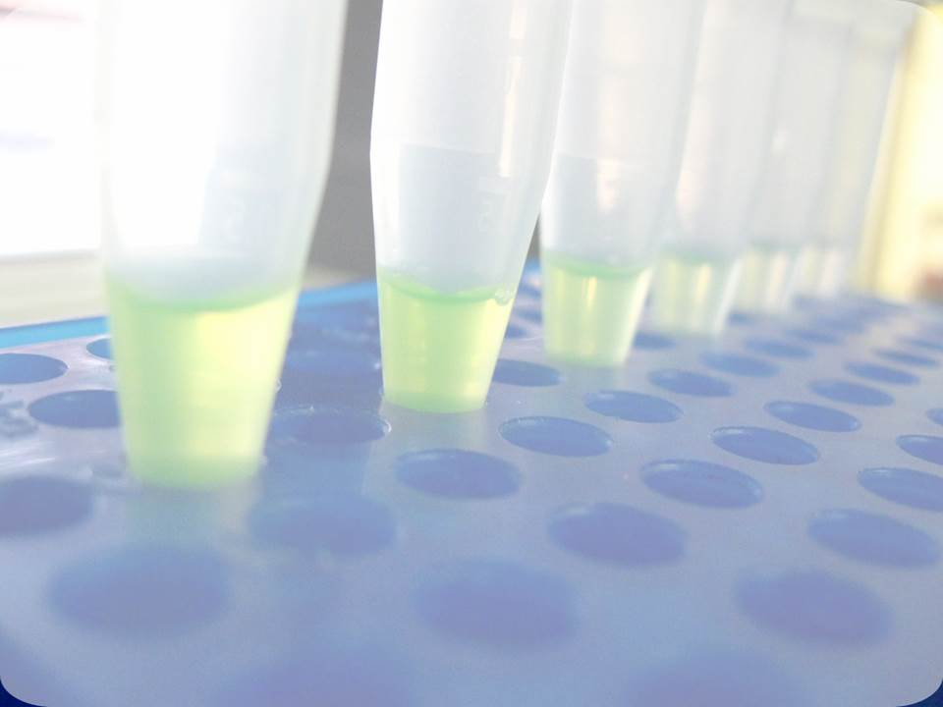

InnoMol
ENHANCEMENT OF THE INNOVATION POTENTIAL IN SEE THROUGH NEW MOLECULAR SOLUTIONS IN RESEARCH AND DEVELOPMENT

Slide 2
1
Kick-off
03.07.2013

Slide 3

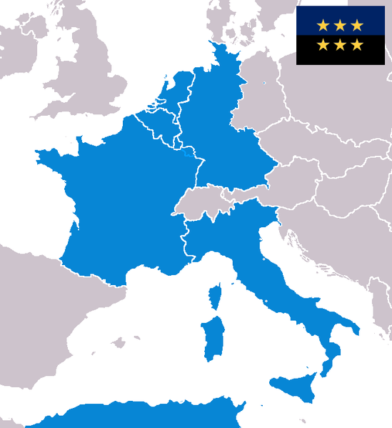
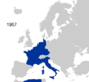



A history of the European Union...
EU founders –
Belgium, France, Germany, Italy, Luxembourg and the Netherlands

Slide 4
A history of proposals...
InnoMol has it’s history, too...
Publication of Call: 22nd December 2006
HEALTH-2007-2.4.4-1: Natural course and pathophysiology of rare diseases

Slide 5
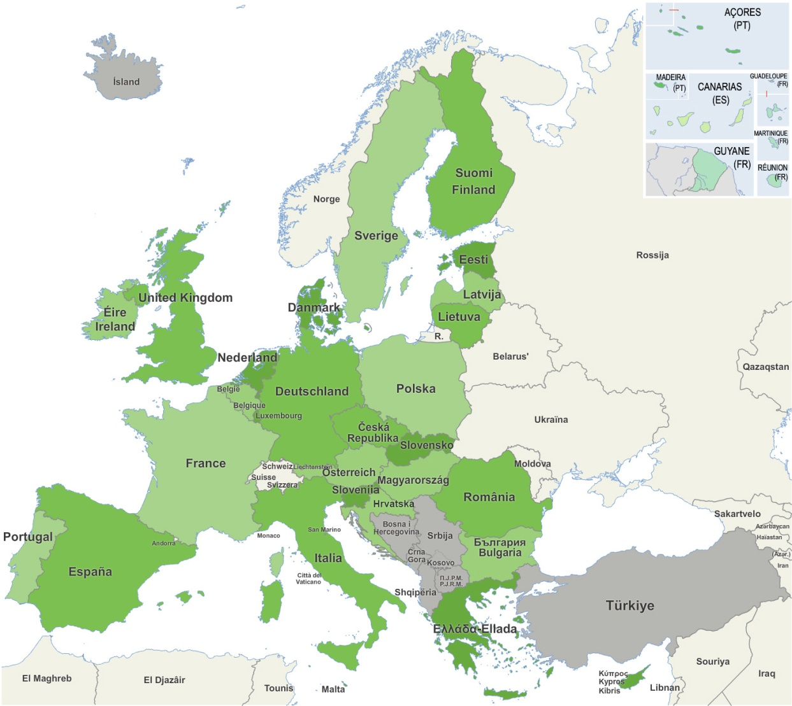

InnoMol history...
Pierre-Olivier Angrand,
IRI
Gerhard Mittler,
MPI
Walter Keller,
UniGraz
Nicola Zambrano, CEINGE
Ulrich Zechner,
HUGI

Slide 6
InnoMol history...
FP7-REGPOT-2008-1: 14. 03. 2008
Mark 8.5 (of 15; below threshold)
FP7-REGPOT-2010-1: 17. 12. 2009
Mark 12.5
FP7- REGPOT-2011-1: 07. 12. 2010
Mark 14
Mark 13.5
Two RBI projects...!

Slide 7
InnoMol history
Call release
20. 07. 2011
Proposal preparation initiaton
11. 11. 2011
Proposal submission
03. 01. 2012
Initial agreement (ZMM, ZMB, OKB)
05. 07. 2011

Slide 8
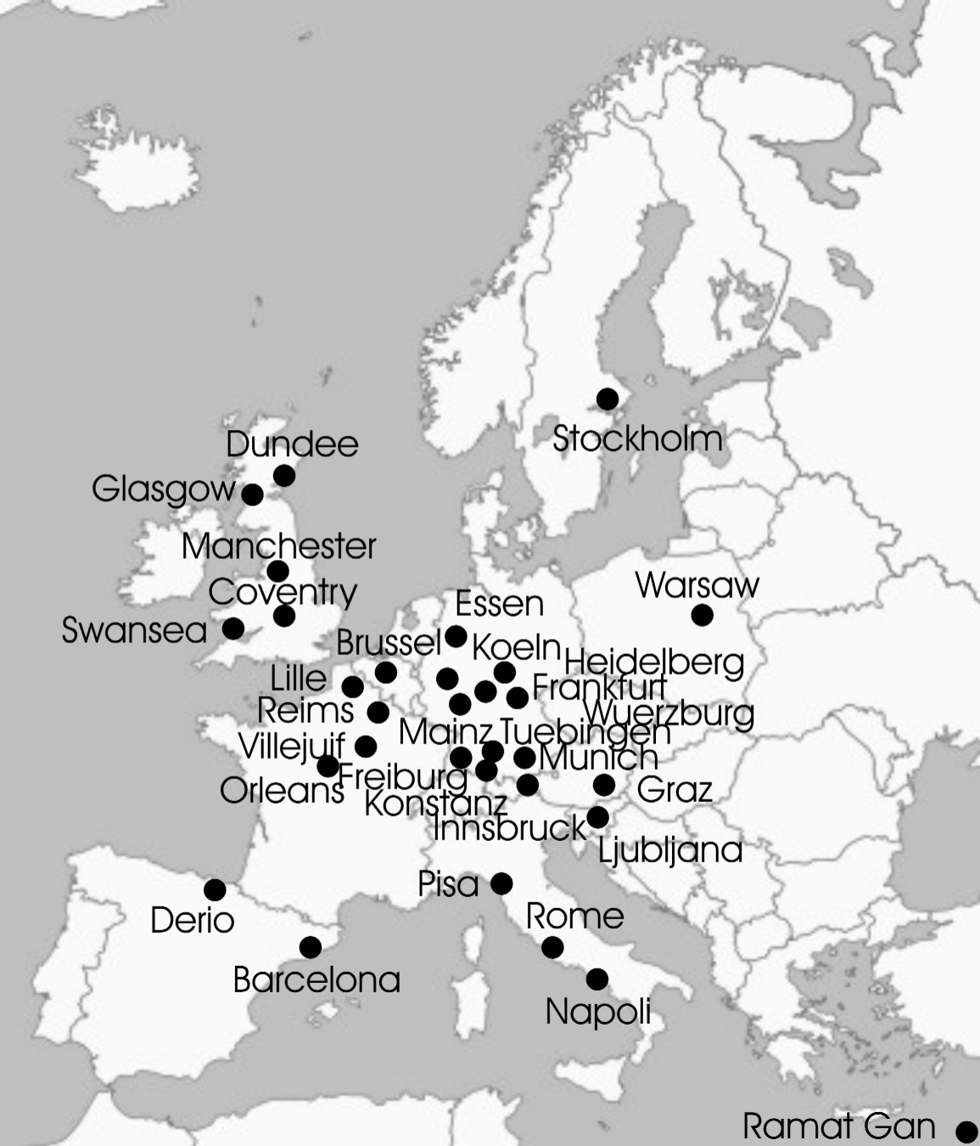

InnoMol network
36 Partners
11 EU members
1 Associated state

Slide 9
InnoMol history
FP7-REGPOT-2012-2013-1: 03. 01. 2012
Enhancement of the Innovation Potential in SEE through new Molecular Solutions in Research and Development - InnoMol
Mark 14 (of 15)

Slide 10
FP7-REGPOT-2012-2013-1
37 Projects
InnoMol
ranked 25th
13 EU members
4 Associated states

Slide 11
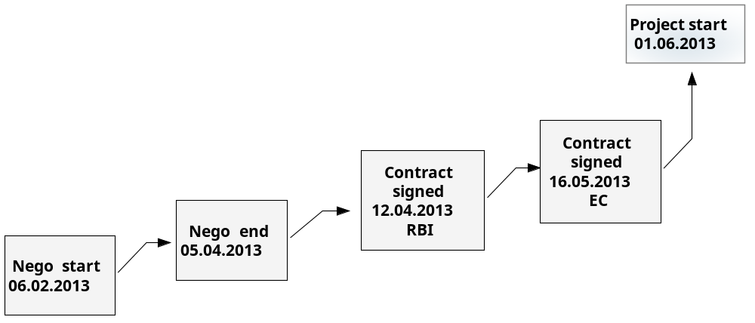
Finally talking with the Commission...

Slide 12

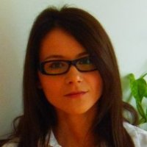
Acknowledgements...
All credits to the InnoMol team, > 50 individuals...
Ana Vidoš
Marketing & Event coordinator at Ruđer Bošković Institute
Petra Buljević Zdjelarević
Head of the PR Office at Ruđer Bošković Institute

Slide 13
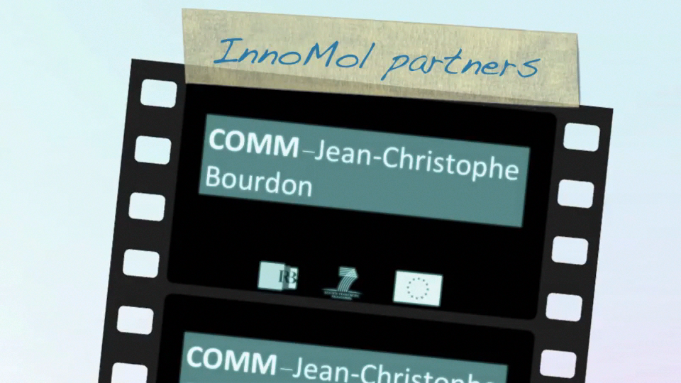
Acknowledgements...

Slide 14
And now the movie...

